Slide 1
Computer Networks
By Jeremiah Kafakoma

Slide 2
definition
A computer network is a set of computers connected together for the purpose of sharing resources. The most common resource shared today is connection to the Internet. Other shared resources can include a printer or a file server.
OR
A computer network is a group of computer systems and other computing hardware devices that are linked together through communication channels to facilitate communication and resource-sharing among a wide range of users. Networks are commonly categorized based on their characteristics.

Slide 3
Networks are used to
Facilitate communication via email, video conferencing, instant messaging, etc.
Enable multiple users to share a single hardware device like a printer or scanner
Enable file sharing across the network
Allow for the sharing of software or operating programs on remote systems
Make information easier to access and maintain among network users

Slide 4
Types of networks
There are many types of networks, including:
Local Area Networks (LAN)
Personal Area Networks (PAN)
Home Area Networks (HAN)
Wide Area Networks (WAN)
Campus Networks
Metropolitan Area Networks (MAN)
Enterprise Private Networks
Internetworks
Backbone Networks (BBN)
Global Area Networks (GAN)
The Internet

Slide 5
Local Area Network
A local-area network (LAN) is a computer network that spans a relatively small area.
Most often, a LAN is confined to a single room, building or group of buildings, however, one LAN can be connected to other LANs over any distance via telephone lines and radio waves.
A local area network (LAN) is a group of computers and associated devices that share a common communications line or wireless link to a server.
A local area network may serve as few as two or three users (for example, in a small-office network) or several hundred users in a larger office.
LAN networking comprises cables, switches, routers and other components that let users connect to internal servers, websites and other LANs via wide area networks.

Slide 6
Wide area Network
A wide area network (WAN) is a geographically distributed private telecommunications network that interconnects multiple local area networks (LANs).
In an enterprise, a WAN may consist of connections to a company's headquarters, branch offices, cloud services and other facilities.
Typically, a router or other multifunction device is used to connect a LAN to a WAN.
Enterprise WANs allow users to share access to applications, services and other centrally located resources.

Slide 7
Metropolitan Area Networks (MAN)
A metropolitan area network (MAN) is a network that interconnects users with computer resources in a geographic area or region larger than that covered by even a large local area network (LAN) but smaller than the area covered by a wide area network (WAN)
The term is applied to the interconnection of networks in a city into a single larger network (which may then also offer efficient connection to a wide area network).
It is also used to mean the interconnection of several local area networks by bridging them with backbone lines.
The latter usage is also sometimes referred to as a campus network.

Slide 8
Advantages/benifits of Networking
Speed. Networks provide a very rapid method for sharing and transferring files. Without a network, files are shared by copying them to floppy disks, then carrying or sending the disks from one computer to another. This method of transferring files in this manner is very time-consuming.
Cost. The network version of most software programs are available at considerable savings when compared to buying individually licensed copies. Besides monetary savings, sharing a program on a network allows for easier upgrading of the program. The changes have to be done only once, on the file server, instead of on all the individual workstations.
Centralized Software Management. One of the greatest benefits of installing a network at a school is the fact that all of the software can be loaded on one computer (the file server). This eliminates that need to spend time and energy installing updates and tracking files on independent computers throughout the building.

Slide 9
Resource Sharing. Sharing resources is another area in which a network exceeds stand-alone computers. Most students cannot afford enough laser printers, fax machines, modems, scanners, and CD-ROM players for each computer. However, if these or similar peripherals are added to a network, they can be shared by many users.
Flexible Access. School networks allow students to access their files from computers throughout the school. Students can begin an assignment in their classroom, save part of it
Security. Files and programs on a network can be designated as "copy inhibit," so that you do not have to worry about illegal copying of programs. Also, passwords can be established for specific directories to restrict access to authorized users.

Slide 10
disadvantages
Costs -Although a network will generally save money over time, the initial costs can be substantial, and the installation may require the services of a technician.
Requires Administrative Time. Proper maintenance of a network requires considerable time and expertise. Many students have installed a network, only to find that they did not budget for the necessary administrative support.
File Server May Fail. Although a file server is no more susceptible to failure than any other computer, when the files server "goes down," the entire network may come to a halt. When this happens, the entire school may lose access to necessary programs and files.

Slide 11
Network components
Basic computer network components. Computer networks share common devices, functions, and what features including servers, clients, transmission media, shared data, shared printers and other hardware and software resources, network interface card(NIC), local operating system(LOS), and the network operating system (NOS).
Hubs and Switches--Hubs are the simplest network devices, and their simplicity is reflected in their low cost. Small hubs with four or five ports
Cables and cabling standards
Network Service Provider (file and printer servers).

Slide 12
links (wired, wireless)
protocols (IP, TCP, CSMA/CD, CSMA/CA)
applications (network services)
humans and service agents
Bridges
Routers
Gateways

Slide 13
Network topologies
A network topology is the pattern in which nodes (i.e., computers, printers, routers or other devices) are connected to a local area network(LAN) or other network via links (e.g., twisted pair copper wire cable or optical fiber cable). There are four principal topologies used in LANs:
Bus- The most widely used of these is bus, because it is employed by Ethernet, which is the dominant LAN architecture. In a bus topology all devices are connected to a central cable, called the bus or backbone. This topology is relatively inexpensive and easy to install for small networks.
Ring-In a ring topology each device is connected directly to two other devices, one on either side of it, to form a closed loop. This topology is relatively expensive and difficult to install, but it offers high bandwidth and can span large distances. A variation is the token ring, in which signals travel in only one direction around the loop, carried by a so-called token from node to node.

Slide 14
Star-In a star topology all devices are connected directly to a central computer or server. Such networks are relatively easy to install and manage, but bottlenecks can occur because all data must pass through the central device.
Mesh-The mesh topology can be either a full mesh or a partial mesh. In the former, each computer is connected directly to each of the others. In the latter, some computers are connected to most of the others, and some are connected only to those other nodes with which they exchange the most data.

Slide 15
Network media
Network media is the actual path over which an electrical signal travels as it moves from one component to another. This chapter describes the common types of network media, including twisted-pair cable, coaxial cable, fiber-optic cable, and wireless.
Twisted-Pair Cable
Twisted-pair cable is a type of cabling that is used for telephone communications and most modern Ethernet networks. A pair of wires forms a circuit that can transmit data. The pairs are twisted to provide protection against crosstalk, the noise generated by adjacent pairs
Two basic types of twisted-pair cable exist: unshielded twisted pair (UTP) and shielded twisted pair (STP). The following sections discuss UTP and STP cable in more detail.

Slide 16
UTP Cable
UTP cable is a medium that is composed of pairs of wires . UTP cable is used in a variety of networks. Each of the eight individual copper wires in UTP cable is covered by an insulating material. In addition, the wires in each pair are twisted around each other.
Shielded Twisted-Pair Cable
Shielded twisted-pair (STP) cable combines the techniques of shielding, cancellation, and wire twisting. Each pair of wires is wrapped in a metallic foil. The four pairs of wires then are wrapped in an overall metallic braid or foil, usually 150-ohm cable
.

Slide 17
Coaxial Cable
Coaxial cable consists of a hollow outer cylindrical conductor that surrounds a single inner wire made of two conducting elements. One of these elements, located in the center of the cable, is a copper conductor. Surrounding the copper conductor is a layer of flexible insulation
Over this insulating material is a woven copper braid or metallic foil that acts both as the second wire in the circuit and as a shield for the inner conductor.

Slide 18
Plenum Cable
Plenum cable is the cable that runs in plenum spaces of a building. In building construction, a plenum (pronounced PLEH-nuhm, from Latin meaning "full") is a separate space provided for air circulation for heating, ventilation, and air-conditioning (sometimes referred to as HVAC), typically in the space between the structural ceiling and a drop-down ceiling.
In buildings with computer installations, the plenum space often is used to house connecting communication cables. Because ordinary cable introduces a toxic hazard in the event of fire, special plenum cabling is required in plenum areas.
Wireless Communication
Wireless communication uses radio frequencies (RF) or infrared (IR) waves to transmit data between devices on a LAN. For wireless LANs, a key component is the wireless hub, or access point, used for signal distribution

Slide 19
Fiber Optic Cables
An optical fiber cable is a cable containing one or more optical fibers that are used to carry light. The optical fiber elements are typically individually coated with plastic layers and contained in a protective tube suitable for the environment where the cable will be deployed.
The Fiber optic networks operate at high speeds - up into the gigabits and they span the long distances between local phone systems as well as providing the backbone for many network systems.
There are three types of fiber optic cable commonly used: single mode, multimode and plastic optical fiber (POF) and the Transparent glass or plastic fibers which allow light to be guided from one end to the other with minimal loss.

Slide 20
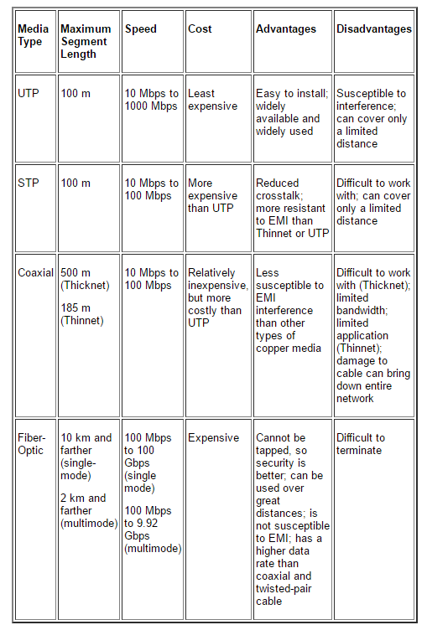

Slide 21
Ethernet Specifications
Over the years, Ethernet has become the most popular media access method to the desktop computer and is used in both small and large network environments.
Ethernet is a nonproprietary industry standard that has found wide acceptance by network hardware manufacturers. Problems related to using Ethernet hardware products from different hardware manufacturers in a single network are nearly nonexistent.
In 1978, the International Organization for Standardization (ISO) released a set of specifications for connecting dissimilar devices.
This set of standards is referred to as the OSI reference model (OSI stands for Open Systems Interconnection). The Ethernet specification performs the same functions as the OSI physical and data-link layers of this model.
these specifications affect how hardware links, or passes information to and from, ISO standards and the standard that pertains to Ethernet is the IEEE 802.3 specification.
Notes:
Institute of Electrical and Electronics Engineers
It promotes the engineering process of creating, developing, integrating, sharing and applying knowledge

Slide 22
OSI reference model
Based upon a proposal first developed by the International Standards Organization (ISO) as a first step in the standardisation of the protocols used in various layers.
It was revised in 1995.
It deals with connecting open systems – the Open Systems Interconnection (OSI) Reference Model – so deals with systems that are open to connection with other systems.

Slide 23
Principles Behind the Model
A layer should be created where a different abstraction is needed.
Each layer has a well-defined function.
Each layer should link to standardised protocols.
Layer boundaries should be chosen to minimize information flow across interfaces.
The number of layers should be sufficient to separate functions but not be unwieldy.

Slide 24
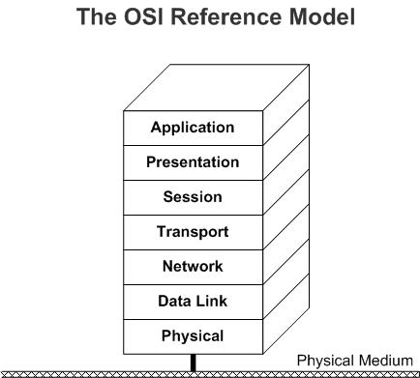

Slide 25
Physical Layer – Layer 1
Concerned with transmitting bits (1s and 0s) over a communication channel.
Design considerations include:
What voltage represents a 1
How long a bit lasts (nanoseconds)
How connection is established
How connection is ended
What connectors are required
Largely mechanical, electrical, timing issues

Slide 26
Data Link Layer – Layer 2
Responsible for communications between adjacent network nodes.
Transforms raw transmitted data into a line of data that is error free and passed to the network layer.
Deals with the different data rates between sender and receiver.
Network Layer – Layer 3
Responsible for establishing paths for data transfer through the network (routing).
Routing can be static so that paths remain constant or dynamic so as to reflect network load.
The network layer is used to overcome differences in addressing, protocols and message sizes.

Slide 27
Transport Layer – Layer 4
Responsible for delivering messages between networked hosts.
Also responsible for fragmentation and reassembly of messages.
Session Layer – Layer 5
Responsible for establishing process-to-process communications between networked hosts.
Establishes sessions between different machines that allow for:
Deciding whose turn it is to transmit;
Preventing simultaneous transmissions;
Synchronisation to allow transmission to continue if there has been a failure mid-transmission.

Slide 28
Presentation Layer – Layer 6
Responsible for defining the syntax which two network hosts use to communicate.
Makes it possible for different systems with different data structures to communicate.
Application Layer – Layer 7
Responsible for providing end-user services, such as file transfers, electronic messaging, email, virtual terminal access, and network management.
This is the layer with which the user interacts.

Slide 29
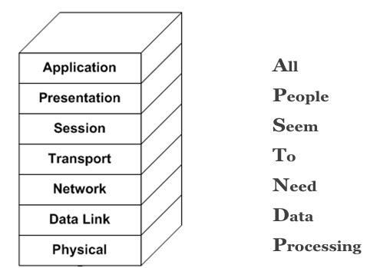
Remembering the Layers

Slide 30
Peer-to-Peer vs. Server-Client
A decision must be made as to whether a peer-to-peer network or server network is required.
Very small networks can be peer-to-peer.
Larger networks should be server based
More than 10 users
Heavy network use
Security is important.

Slide 31
servers
A server is a computer or series of computers that provides services across the network.
The server is at the Centre of a network.
Most large networks with more than a few dozen workstations rely on several network servers.
The requirements of the server hardware are determined by size of network, network operations, network operating system, etc.

Slide 32
Specialist Servers
It is possible to assign servers to specific roles such as:
Application servers
Communication servers
Domain controllers/directory servers
Fax servers
File servers
Print servers
Mail servers
Web servers

Slide 33
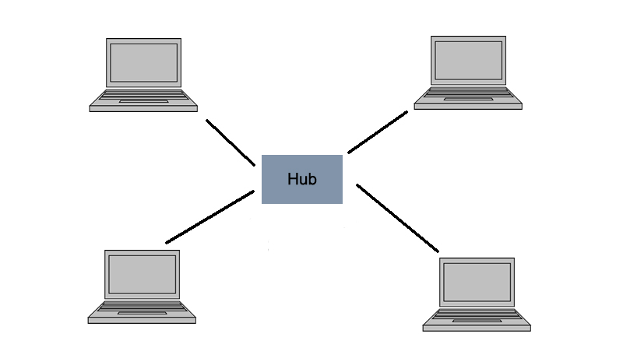
Peer-to-Peer Networks - 1

Slide 34
Works well in small networks
Every user acts as a network administrator.
Are flexible but can become chaotic as they grow
Security can be a major concern as it is difficult to enforce security across the whole network.
Computers can be grouped into workgroups.
As the network grows, it can be very difficult to manage.

Slide 35
Advantages of Peer-to-Peer
Easy to install and configure
Users control their own shared resources.
Inexpensive to purchase and operate
Need no additional equipment or software
No dedicated administrators are needed.

Slide 36
disadvantages
Security applied resource by resource
May need as many passwords as there are shared resources
Each PC must be backed up to protect shared data.
PC performance is reduced when a shared resource is accessed.
No centralized approach to store or control access to data.
No access to a resource if PC storing it is unavailable

Slide 37
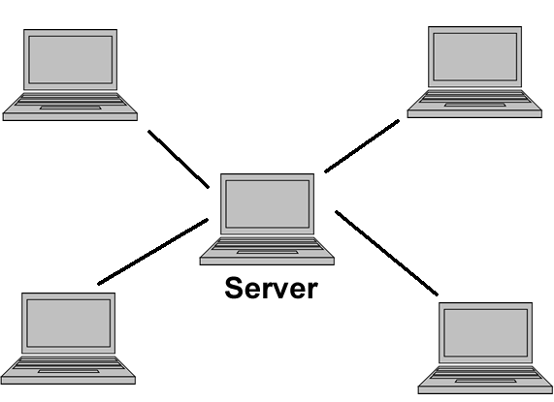
Client-Server Networks - 1

Slide 38
Client-Server Networks - 2
Works well in larger networks
Central server provides services and files
Server-based networks are the most common.
Servers can have specific functions, e.g.
File
Print
Clients may be standard PCs or thin-clients with no storage media.

Slide 39
Advantages of client-server
Network administration simplified by centrally controlled user accounts, security, etc.
More efficient access to resources
Server hardware design is more robust
A single password gives access to network-wide resources.
Used for networks with 10 or more users or any networks with high usage

Slide 40
disadvantages
Server failure causes major problems:
May make whole network unusable
Will at least result in loss of network resources
Complex server software
Requires allocating expert staff
Increases costs
Dedicated hardware and specialized software add to the cost of server-based networking.

Slide 41
Ethernet Issues
Cable breaks
What happens if there is a break in the cable?
Signal reflection
A message is an electrical signal. What happens when it reaches the end of the cable?
Collisions
How does the network determine who has the right to send a message? What happens if two nodes send messages at the same time?

Slide 42
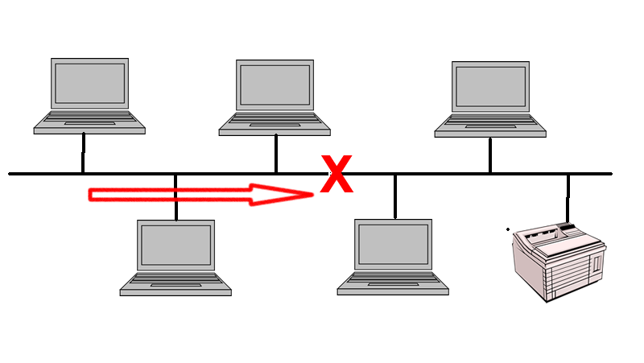
Cable Breaks
There is a split in the network, so communication is impossible between the two sections.

Slide 43
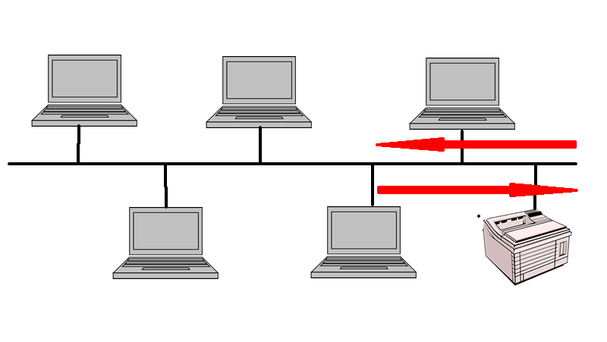
Signal Reflection
The messages passed are simple electrical signals
These will be reflected at cable ends and appear as a collision

Slide 44
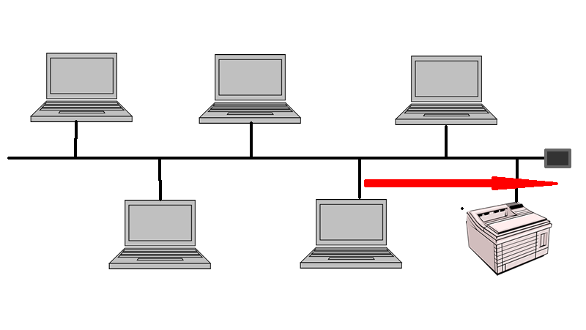
Cable Termination
Reflection is prevented by having the cable terminated with a resistor
This dissipates the signal and prevents reflection

Slide 45
Topology
To install a network, you need to know how to connect all the elements together.
A network topology is the layout of computers, cables and peripherals and also the paths that data travels along on the network.
There are two forms of network topology:
Physical topology
Logical topology
Physical and logical topology may differ.

Slide 46
Network Elements
There are two main components of a network:
Nodes
Links
A network node is an intersection between links that will contain some equipment:
To aid signal transmission (hub, switch, bridge, etc)
For data processing (computer, printer, etc)
A link is the media through which the signals are transmitted (fibre-optic, coaxial cable, RF, etc)

Slide 47
Physical Topology
Explains how the computers and peripherals are physically connected together
It is a map showing how each piece of hardware is connected to the other hardware on a network.
This may be via physical cables or could be wireless.

Slide 48
Logical Topology
Explains how data passes between network devices
It is a map showing the logical path of data around the network.
The logical topology of a network may be different to its physical topology.

Slide 49
Topology Categories
There are many different topologies.
There are many different technologies for physical connections.
There are many different protocols for logical connections.
We can broadly categorise networks as:
Point-to-point networks
Broadcast networks

Slide 50
Point-to-Point Networks
Many connections between individual pairs of machines
Packets of information may have to pass through intermediate machines.
Multiple routes of different length are possible, so routing algorithms are used.
Generally used in larger networks (e.g. Internet)

Slide 51
Broadcast Networks
Single communication channel that is shared by all the machines on the network
Packets sent by a machine are received by all the others.
Address field specifies the recipient
Generally used for smaller networks (LANs)

Slide 52
Collisions
Before transmitting a signal, a node listens to the network and only transmits if there is no traffic.
This does not prevent two nodes transmitting at the same time.
If two or more nodes broadcast at the same time, there is a collision and the message cannot be received.
A method is required for dealing with this.

Slide 53
Data flow control ( bus, csma/cd, ring-token
In data communications, flow control is the process of managing the rate of data transmission between two nodes to prevent a fast sender from overwhelming a slow receiver.
Carrier sense multiple access with collision detection (CSMA/CD) is a media access control method used most notably in local area networking using early Ethernet technology. It uses a carrier sensing scheme in which a transmitting data station detects other signals while transmitting a frame, and stops transmitting that frame, transmits a jam signal, and then waits for a random time interval before trying to resend the frame.
CSMA/CD is a modification of pure carrier sense multiple access (CSMA). CSMA/CD is used to improve CSMA performance by terminating transmission as soon as a collision is detected, thus shortening the time required before a retry can be attempted.

Slide 54
ISDN (Integrated Services Digital Network)
ISDN (Integrated Services Digital Network) is a set of CCITT/ITU standards for circuit-switched transmission of data over various media, including ordinary telephone-grade copper wire.
It is a set of communication standards for simultaneous digital transmission of voice, video, data, and other network services over the traditional circuits of the public switched telephone network. It was first defined in 1988 in the CCITT red book. Prior to ISDN, the telephone system was viewed as a way to transport voice, with some special services available for data.
The key feature of ISDN is that it integrates speech and data on the same lines, adding features that were not available in the classic telephone system. The ISDN standards define several kinds of access interfaces, such as Basic Rate Interface (BRI), Primary Rate Interface (PRI), Narrowband ISDN (N-ISDN), and Broadband ISDN (B-ISDN).
Notes:
CCITT/ITU stands for Consultative Committee for International Telephony and International telegraph Union they define standards of data communications

Slide 55
CSMA/CD
Carrier Sense Multiple Access with Collision Detection
A simple protocol
Any node can send a message when the network is free.
If the cable is busy, it waits until it is free.
Removes a lot of unnecessary waiting time by allowing transmission at any time.
CSMA/CD Collisions
Two nodes may detect that the network is free at any one time and both transmit.
The signals collide preventing either from being received.
Energy levels on the line are increased and the collision is detected, nodes then:
Stop transmitting
Wait for a random back-off interval
Then attempt to retransmit

Slide 56
CSMA/CD Characteristics
No predetermined transmission order
No guaranteed wait time before transmission
Probability of collision increases as data rates increase - network saturates before theoretical limit
Nodes transmitting at a high rate tend to take over the network.
FAST ETHERNET
Ethernet originally ran at 5Mbps, then 10 Mbps
This is too slow for many applications
Fast Ethernet was introduced that ran CSMA/CD at speeds of 100Mbps
This was followed by Gigabit Ethernet at speeds of 1000Mbps
100 Gigabit Ethernet is now a formal standard
It is suggested that Terabit Ethernet will be available by 2015

Slide 57
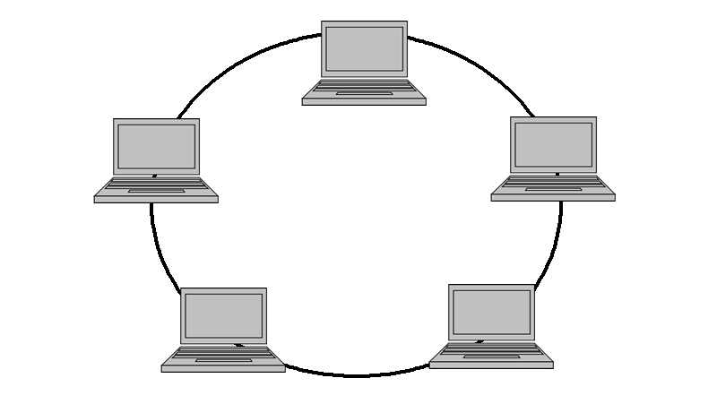
Token Ring
All nodes are connected in a ring
IEEE 802.5
Now mainly present in legacy IBM systems

Slide 58
Token Passing
A token is a special frame that circulates the ring, node by node
Only the node in possession of the token can transmit
Messages pass around the ring until they reach the destination node
The transmitting node then passes the token to the next node
Fairly distributes right to transmit
PROBLEM
Transmission is one way, a break in the ring stops transmission
Modern rings are physically star shaped and operate through a hub that automatically removes damaged nodes thus “fixing” the ring

Slide 59
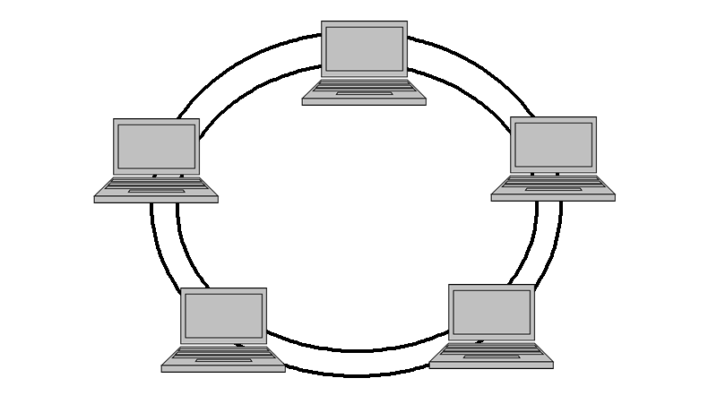
FDDI
Fibre Distributed Data Interface
Double ring transmitting in two directions, so transmission is possible if one ring is broken
Now not a competitive technology

Slide 60
ATM
Asynchronous Data Transfer Mode
Intended as a replacement for telephony and data networks
Uses a cell switching approach for high data rate transmission
Has been widely used as a LAN backbone technology, despite requiring complicated interfaces
Now overtaken by Gigabit Ethernet

Slide 61
DHCP
Client-server networks often allow for devices to be added and removed
The Dynamic Host Configuration Protocol is often used to assign unique IP addresses to devices
The address can be released when a device leaves the network
This same address can then be allocated to another device when it joins

Slide 62
Peer-to-Peer (P2P) Networks
Nodes generally have their own hard drive
Nodes often have their own peripheral devices
Control of a node is autonomous
Resources are shared at the discretion of individual users
Individual nodes can act as both clients and servers

Slide 63
What is the Internet?
A collection of networks that use common protocols to provide common services.
Uses the TCP/IP reference model
Uses the TCP/IP protocol stack
To be part of the Internet, a computer must also:
Have an IP address
Be able to send IP packets to other machines on the Internet

Slide 64
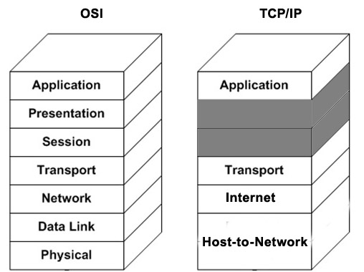
TCP/IP Reference Model
Has 4 layers

Slide 65
Host-to-Network Layer
Not specified in detail in the model
The host has to connect to the network via some protocol
The protocol must allow it to send IP packets
Internet Layer
Permits hosts to inject packets into any network and travel independently to their destination
Packets may be delivered in any order
Role is to ensure packets get to the right address
The Internet Protocol (IP) is responsible for this
The internet layer is present in the Internet but not specific to the Internet
Packet switching is the key function

Slide 66
Transport Layer
Is designed to allow source and destination to have a conversation
Uses one of two protocols:
Transmission Control Protocol (TCP)
User Datagram Protocol (UDP)
Comparable to the OSI Transport Layer

Slide 67
Application Layer
The TCP/IP model does not have session or presentation layers
This layer consists of high level protocols such as:
File Transfer Protocol (FTP)
Simple Mail Transfer Protocol (SMTP)
HyperText Transfer Protocol (HTTP)

Slide 68
Internet Protocol
Defines the rules that determine how packets are transferred from one host to another
It is not a reliable protocol:
Packets may not be delivered
Packets may be delivered out of sequence
Every host must have a unique IP address that identifies it.

Slide 69
IPv4 Addresses
Internet Protocol version 4
Each address is a dotted quad in the form 101.4.233.1
Each address is made up of four decimal numbers between 0 and 255 separated by a dot
Each address is 32 bits
2³²= 4 294 967 296 possible addresses

Slide 70
SUBNETS
A subnet is a logical subdivision of an IP network.
Subnets are meaningless to any router outside the business.
Internal routers can use this to route packets to the relevant subnet work.
By organizing hosts into logical groups, subletting can improve network security and performance.

Slide 71
Subnet Addressing
The most significant part of the address is used to indicate which network is intended, e.g. 192.168.1.0.
Devices on this subnet have addresses in the range 192.168.1.1 - 192.168.1.254.
192.168.1.255 cannot be assigned as it is reserved for broadcast.
Multiple subnets can be used on one network.

Slide 72
Multiple Subnets
A router could have the address 192.168.0.0.
There could be a number of subnets within an address:
192.168.1.0
192.168.2.0
192.168.3.0
Etc.

Slide 73
IPv6
Problem with IPv4 - Not enough addresses
Solution – a new version of IP
IP version 6 addresses are made up of 128 bits.
2¹²⁸, or about 3.403×10³⁸, unique addresses
Represented by 8 groups of 16-bit hexadecimal values separated by colons, e.g. 2001:0db8:85a3:0000:0000:8a2e:0170:4334
Many applications do not yet support IPv6.

Slide 74
From IPv4 to IPv6
Address increased from 32-bit to 128-bit
Allows node to specify the message path
Smaller header but addresses are longer
Allows for more header options in the future
Quality of service capabilities allow non-standard handling of packets
Allow for the handling of authentication, confidentiality and data integrity

Slide 75
Transmission Control Protocol - 1
Designed to provide reliable delivery for IP
Takes care of breaking data into packets and reassembling at the destination host
Checks if packet is corrupted and requests a resend if it is
Checks number of packets and requests replacement if one is missing
Handles timeouts and transmission errors

Slide 76
A connection-oriented protocol - a connection is established and maintained until such time as the messages have been exchanged
Establishes a full duplex virtual connection between two endpoints
Each endpoint is defined by an IP address and a TCP port number
Used with WWW, email and file transfer

Slide 77
User Datagram Protocol
A simple transmission model using headers of only 8 bytes
Does not provide:
Reliability
Ordering
Data integrity
Assumes error checking and correction is not necessary
Does not have the delays that can be associated with TCP
Used with IP in time-sensitive applications:
Gaming
Voice over IP (VoIP)
DNS

Slide 78
File Transfer Protocol
Uses TCP/IP to transmit/receive
Works at the application layer
Uses a generic file structure that is independent of the operating system
Allows file transfer between dissimilar hosts

Slide 79
Simple Mail Transfer Protocol
Uses TCP/IP to transmit
Does not provide a user interface for sending and receiving messages
Many Internet email applications do provide interfaces.
Commonly used for sending email
Most email clients use POP3 or IMAP for incoming mail.

Slide 80
Hypertext Transfer Protocol
Used throughout the World Wide Web for sending messages and getting responses from servers
Most common method is the GET method to request and receive a web page
Other common methods are:
PUT
POST
DELETE
TRACE

Slide 81
Creating a Network Layout
A network layout must be documented in a diagram.
Factors to consider
Number of client computers
Number of servers
Will there be an Internet connection?
The architecture of the building
The best topology or topologies
Any diagram must be updated if the layout changes
Version control.

Slide 82
Physical Media
Factors to consider when choosing network media:
Bandwidth rating
Maximum segment length
Maximum number of segments per internetwork
Maximum number of devices per segment
Interference susceptibility
Connection hardware
Cable grade
Bend radius
Costs of materials and insulation

Slide 83
Network Security Threats
This topic will cover:
Network security threats
Security countermeasures
Security software
Installing and configuring security software
Tasks of Network Security
Must ensure the network offers:
Privacy
Integrity
Availability

Slide 84
Network Privacy
Network security should ensure that only authorised users can access network services.
Transmitted data cannot be accessed by unauthorised users and/or is unintelligible to unauthorised users.
There are consequences if privacy is breached.
Embarrassment
Financial loss
Company secrets
Network Integrity
Network security should ensure that data transmitted on the network:
Is not lost
Is not modified
Is not corrupted

Slide 85
Network Availability
Network security should ensure that the network is available for use:
When needed
Providing the required services
Network Security Problems
Software
Protocol design
System configurations
Actions of people
Accidents & natural events

Slide 86
The Security Policy
Most large organisations have a security policy.
Focuses attention on the importance of security
Shows management backing
Often includes key policies for users:
Acceptable use policy
Authorisation levels
Roles and responsibilities

Slide 87
Acceptable Use Policy
A set of rules that lay out how the network may be used
New users should be asked to sign their acceptance of the policy before being provided with network access
Ideally, this should outline the sanctions on users who break the policy
Authorization
Authorisation is the function of specifying access rights to resources for authorised users
A network should have a policy whereby users are granted access to resources based upon their grade, department, etc.
This can be done in a number of ways, e.g.
Individually
Allocating user to a domain and allocating access rights to a domain

Slide 88
Roles and Responsibilities
A security policy should allocate specific functions to specific job roles.
Roles should be allocated in such a way that fraud is made difficult.
Actual roles and responsibilities depend upon:
Function of the organisation
Size of the organisation

Slide 89
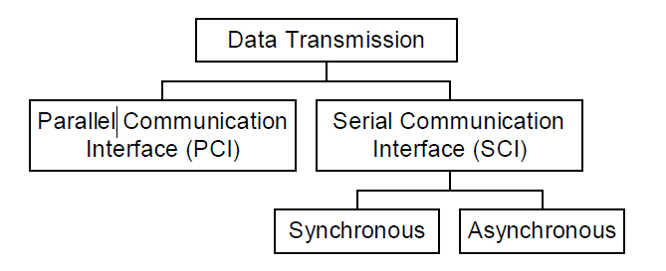
Transmission techniques
In this chapter we will look on some data transmission techniques which are
Parallel Data Transmission
Serial Data Transmission
Introduction to Communication Interface

Slide 90
Data transmission
Data transmission is the process of sending digital or analog data over a communication medium to one or more computing, network, communication or electronic devices.
It enables the transfer and communication of devices in a point-to-point, point-to-multipoint and multipoint-to-multipoint environment.
Parallel Data Transmission
In parallel transmission, multiple bits (usually 8 bits or a byte/character) are sent simultaneously on different channels (wires, frequency channels) within the same cable, or radio path, and synchronized to a clock.

Slide 91
Network Performance
Determine if there is anything different since the network last functioned normally:
New equipment
New applications
Check network users:
New users
Game playing/videos
Check for equipment that may cause interference.

Slide 92
Wiring standards
The wiring standards for RJ45 data jacks and plugs, according to ANSI, TIA & EIA, includes two variations: T568A and T568B.
These two standards are very similar. In fact, the only visible difference between the two is that pairs 2 and 3 (green & orange) are swapped.
TIA/EIA-568 is a set of telecommunications standards from the Telecommunications Industry Association (TIA), an offshoot of the Electronic Industries Alliance (EIA).
The standards address commercial building cabling for telecommunications products and services.

Slide 93
How are T568A and T568B similar?
The main similarity between T568A and T568B is that they both provide wiring schemes for terminating twisted-pair copper network cable (CAT cables) to 8-position RJ45 jacks and connectors. “8 position” refers to the fact that RJ45 data transmission requires 8 conductors, which are provided by the 4 twisted wire pairs found in the copper-based network cable we just mentioned.
The pairs in this type of cable are based on four colors (blue, orange, green and brown), with each of pair consisting of solid-colored wire twisted together with another wire that’s of the same color, but striped with white.
When untwisted, the 4 pairs result in 8 individual wires: one for each pin of the jack or plug.

Slide 94
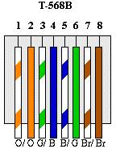
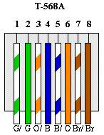

Slide 95
Troubleshooting Method
Determine what the problem is
Gather relevant information
Consider possible causes
Devise a potential solution
Implement the solution
Test the solution
Document the solution
Implement methods to prevent reoccurrence

Slide 96
Troubleshooting tools
Experience
Data sources (Internet, manuals)
Network documentation
Digital voltmeters
Time-domain reflecto meters
Cable testers
Network monitors
Protocol analyzers

